Slide 1
Full stack Development HTML
By:
Prashant Tomer

Slide 2
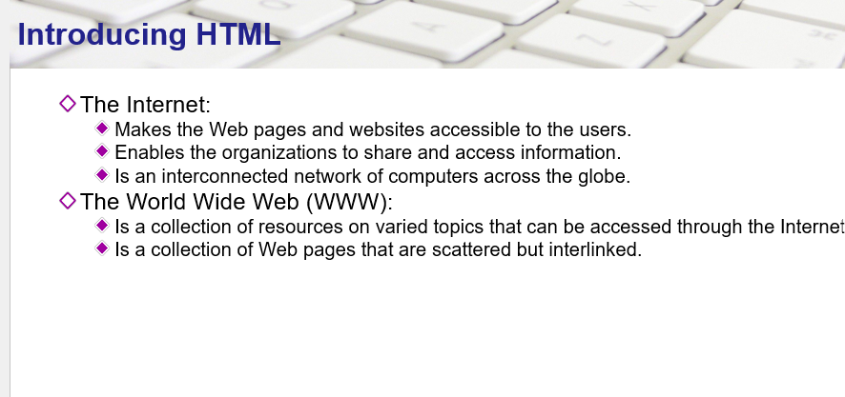

Slide 3
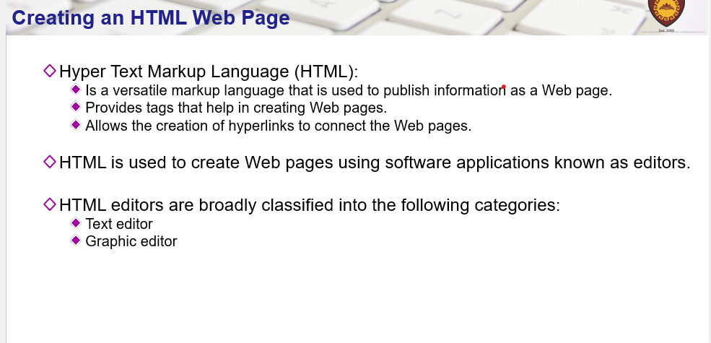

Slide 4
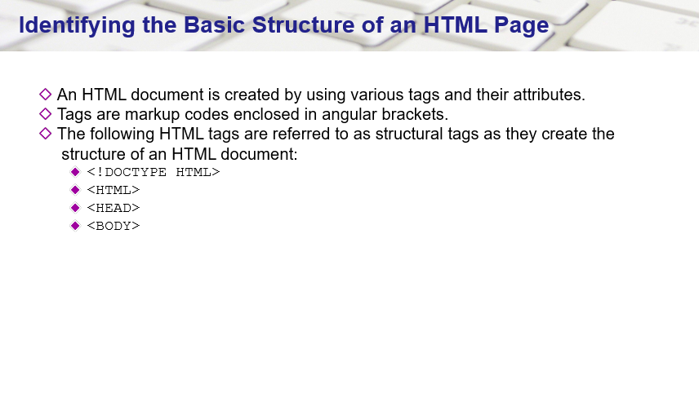

Slide 5
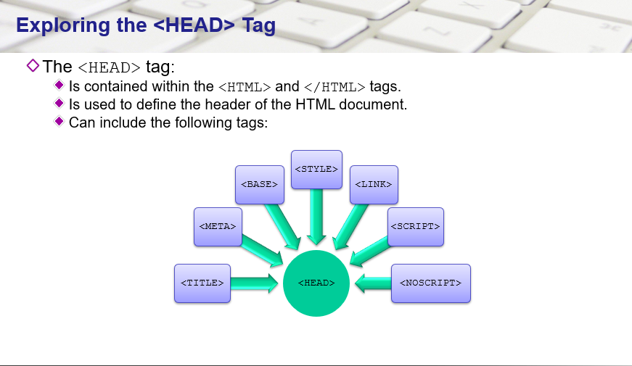

Slide 6
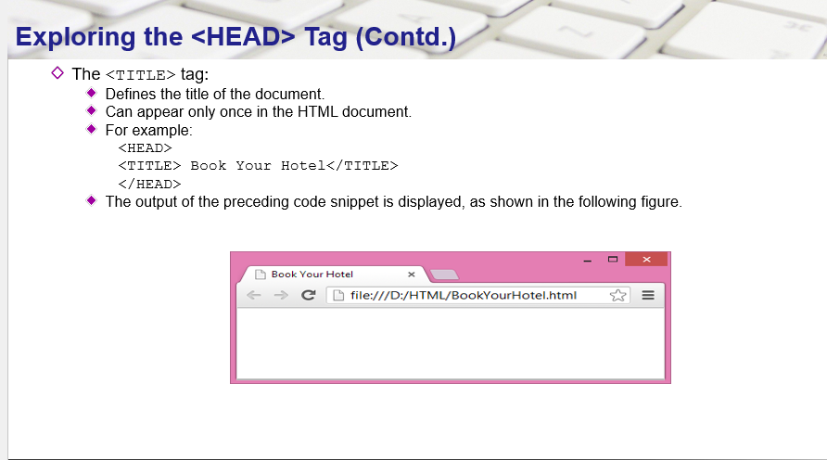

Slide 7
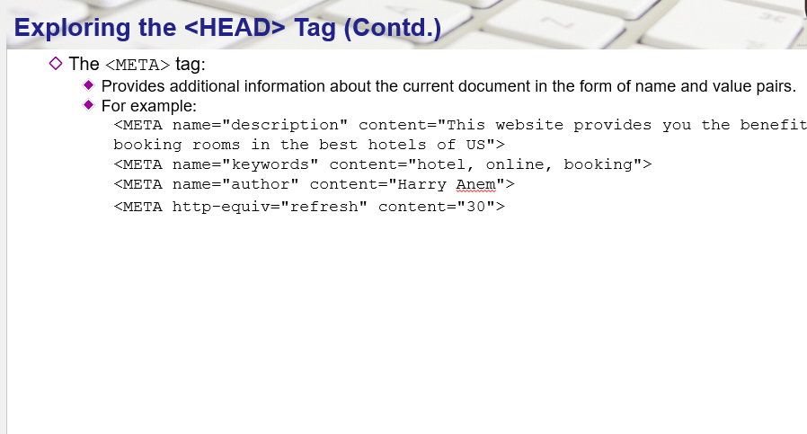
<meta http-equiv="refresh" content="3;url=https://www.linkedin.com/mynetwork/" />

Slide 8
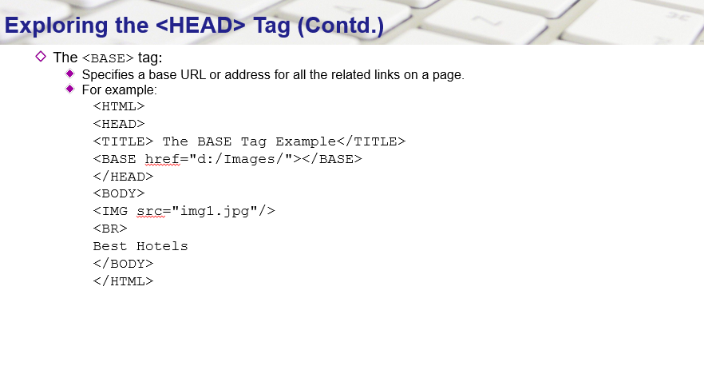

Slide 9
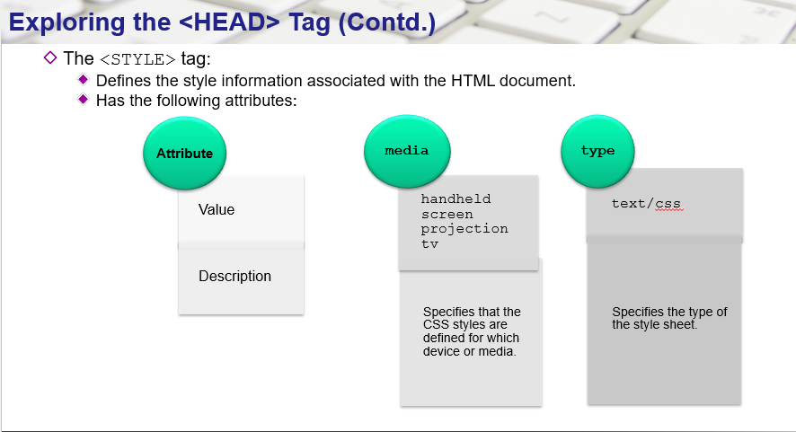

Slide 10
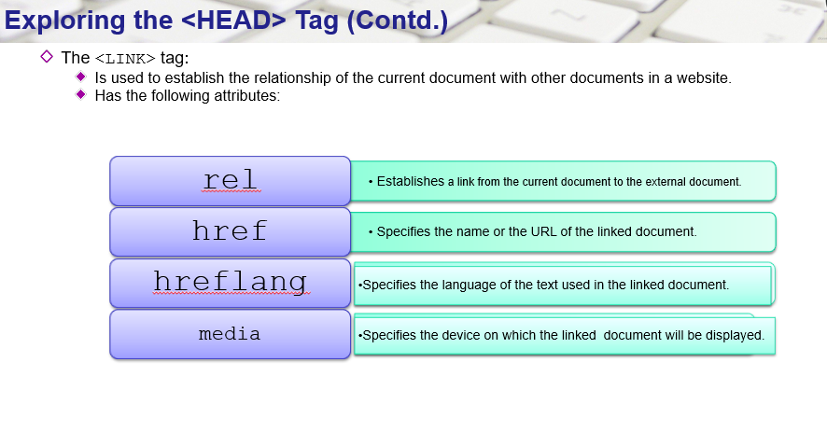

Slide 11
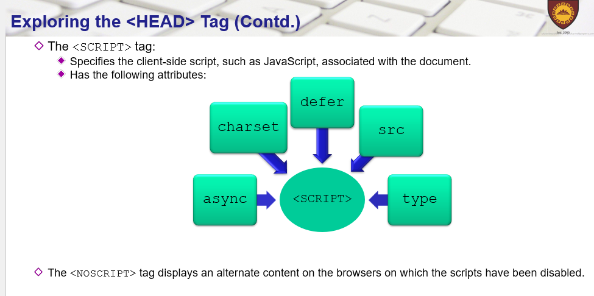

Slide 12
Demo
Create a Simple HTML Document in Microsoft Visual Studio.

Slide 13
Marquee
Attributes
Direction:
Sets the direction of the scrolling within the marquee
Possible values are left, right, up and down.
Default value is left
Bgcolor:
Sets the background color through color name or hexadecimal value.

Slide 14
Height:Sets the height in pixels or percentage value.
Width: Sets the width in pixels or percentage value.
Hspace: set the horizontal margin
Vspace: Sets the vertical margin in pixels or percentage value.
Loop: Sets the number of times the marquee will scroll. If no value is specified, the default value is −1, which means the marquee will scroll continuously.

Slide 15
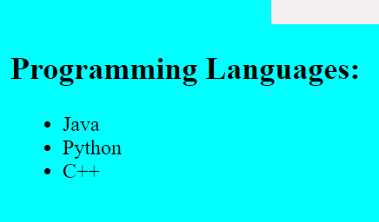
Lists
HTML supports unnumbered, numbered, and definition lists, and includes the ability to nest lists.
Unnumbered, bulleted List
<h2>Programming Languages:</h2>
<ul>
<li>Java
<li> Python
<li> C++
</ul>

Slide 16
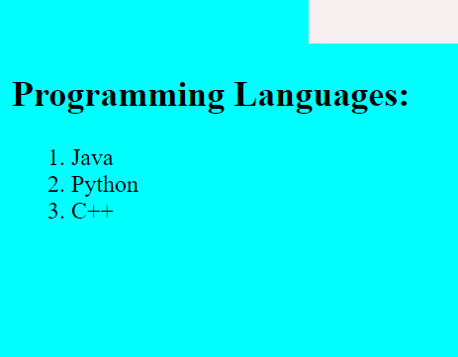
Numbered (Ordered) List A numbered list (also called an ordered list, from which the tag name derives) is identical to an unnumbered list, except it uses <OL> instead of <UL>. The items are tagged using the same <LI> tag. The following HTML code:
<ol>
<li>Java
<li> Python
<li> C++
</ol>

Slide 17
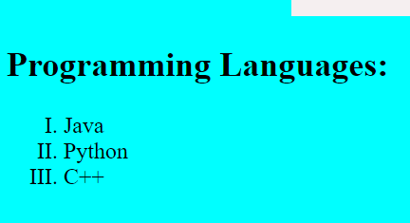
Attribute:
Type:
a: lowercase letters
A: uppercase letters
i: lowercase Roman numerals
I: uppercase Roman numerals
1: numbers
<h2>Programming Languages:</h2>
<ol type='I'>
<li>Java
<li> Python
<li> C++
</ol>

Slide 18
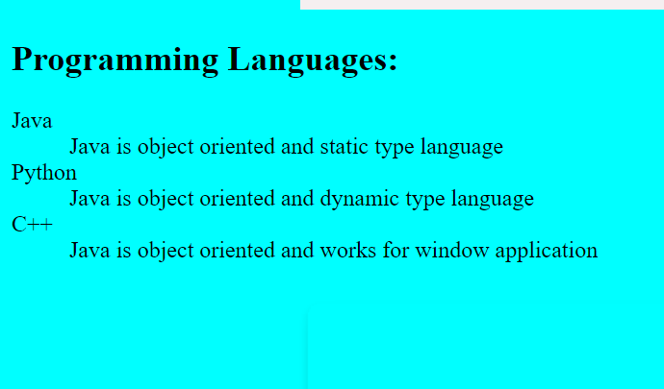
Definition Lists A definition list usually consists of alternating a definition term (the 'heading') and a definition definition (its description).
<h2>Programming Languages:</h2>
<dl>
<dt>Java
<dd> Java is object oriented and static type language
<dt> Python
<dd>Java is object oriented and dynamic type language
<dt> C++
<dd> Java is object oriented and works for window application
</dl>

Slide 19
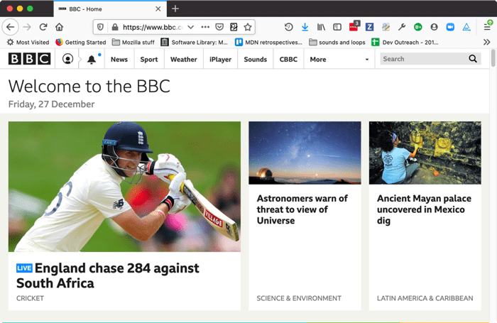
HyperLinking
Hyperlinks allow us to link documents to other documents or resources, link to specific parts of documents, or make apps available at a web address.

Slide 20
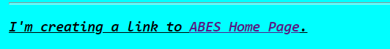
Anatomy of a link
inside an <a> element and using the href attribute, also known as a Hypertext Reference, or target, that contains the web address:
<p>I'm creating a link to
<a href="https://modernizr.com/docs">ABES Home Page</a>.
</p>

Slide 21

Attribute:
Title: information about the page you linked through href.
Add Image as a link:
<p>I'm creating a link to
<a href="https://modernizr.com/docs">
<img src="C:\Users\Tomer\Desktop\abeslogo.png" alt="ABES Logo">

Slide 22
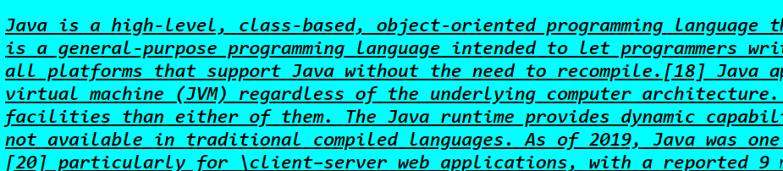
Documents Fragments
Learn <a href="#java" >Java Programming</a>
Learn <a href="#python" >Python Programming</a>
Source for #java
<h3 id="java">
Java is object oriented pogramming….
</h3>

Slide 23
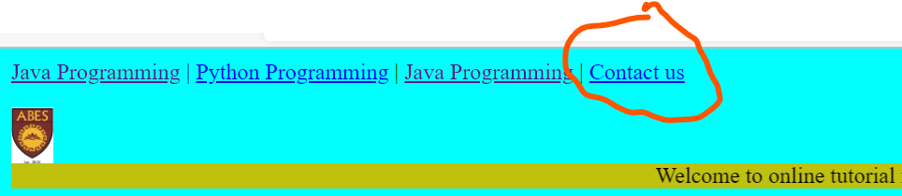
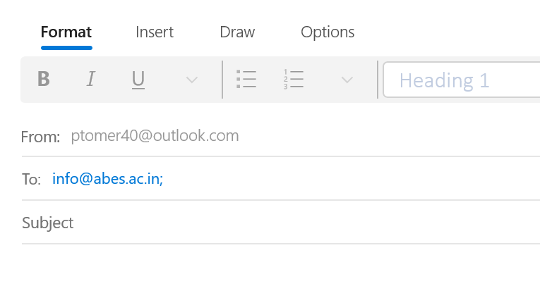
Mailto: This anchor makes it possible for the user to create an email to a specific address. The format is:
<a href="mailto:info@abes.ac.in">Contact us</a>

Slide 24
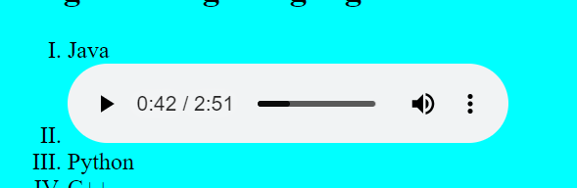
Audio tag:
<audio controls>
<source src=“file.mp3” type=“audio/mpeg”>
Your browser does not support the audio tag.
</audio>

Slide 25

Video tag:
<video width=“300” height=“200” controls>
<source src=“file.mp4” type=“video/mp4”>
</video>

Slide 26
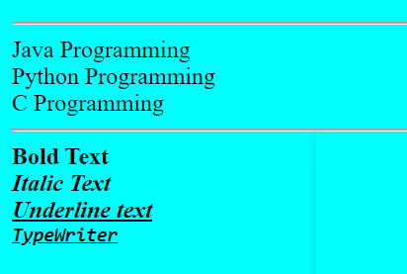
Working on Text
<br>: break the line
<HR>: for Horizontal Line
Physical Styles:
<B></B>: Bold the text
<I></I>: Italic the text
<U></U>: underline the text
Example:
<HR>
Java Programming<BR> Python Programming <BR> C Programming<BR> <HR> <B>Bold Text</B> <BR> <I>Italic Text </I><BR> <U>Underline text</I>
<BR>
<TT>TypeWriter

Slide 27
blockquote:
The <blockquote> tag specifies a section that is quoted from another source.
<blockquote cite=“abes.ac.in">
WWF has been protecting the future of nature. The world's leading conservation organization, WWF works in 100 countries and is supported by 1.2 million members in the United States and close to 5 million globally.
</blockquote>

Slide 28

Abbreviations:
<p>We use <abbr title="Java Programming develop by sun microsystems">Java</abbr> to develop the web application</p>
Address:
<address>
Chris Mills, Manchester, The Grim North, UK
</address>

Slide 29
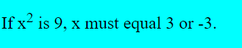
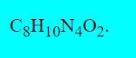
Superscript and subscript:
Superscript
<p>If x<sup>2</sup> is 9, x must equal 3 or -3.</p>
Suberscript:
C<sub>8</sub>H<sub>10</sub>N<sub>4</sub>O<sub>2</sub>.</p>

Slide 30
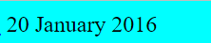
Marking up times and dates
HTML also provides the <time> element for marking up times and dates in a machine-readable format.
<time datetime="2016-01-20T19:30">7.30pm, 20 January 2016</time>

Slide 31
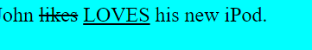
<ins> and <del>
If you're wanting to display editing revisions with with markup, <ins> and <del> are just the ticket. Like the name implies, <ins> highlights what's been added to the document with an underline, and <del> shows what's been taken out with a strikethrough.
John <del>likes</del> <ins>LOVES</ins> his new iPod.

Slide 32
Special Symbol
&copy;→ Copyright Sign
&reg ; → Registerd Sign
&euro;→ Euro Sign
&trade;→ Trade mark
&larr;→Left Arrow
&rarr;→ Right Arrow
&uarr;→ Upward Arrow
&darr;→ Downward Arrow

Slide 33
HTML
Table, Frame and Form

Slide 34
HTML TABLE
The HTML table model allows authors to arrange data -- text, preformatted text, images, links, forms, form fields, other tables, etc. -- into rows and columns of cells.
It can also be used to create the layout of a web page.
<table>: This tag is creates a table on the web page. But without any additional tags to determing the table rows <tr> and cells <td>, nothing will appear on your page. A table is constructed using these tags in the same way you'd build a brick wall. Each row begins with a layer of cement <tr> and then each brick <td> is placed within it.
TR-Table Row
TD-Table Data
TH-Table Header

Slide 35
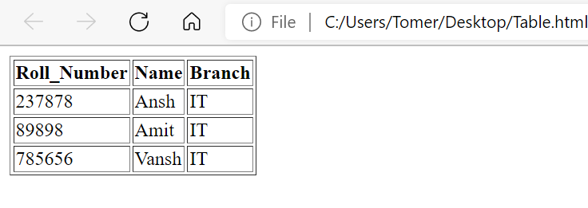
Sample Table
<Html>
<head>
<title>HTML TABLE</title>
</head>
<body>
<table border=1>
<tr>
<th>Roll_Number</th><th>Name</th><th>Branch</th>
</tr>
<tr>
<td>237878</td><td>Ansh</td><td>IT</td>
</tr>
<tr>
<td>89898</td><td>Amit</td><td>IT</td>
</tr>
<tr>
<td>785656</td><td>Vansh</td><td>IT</td>
</tr>
</table>
</body>
</Html>

Slide 36
Attributes for the <table> tag:
align - This can force the table to align to either the left, right, or center of the browser's window.
background - This attribute points to the location of an image file that will be displayed in the background of the table. If the image is smaller in dimentions than the table's borders, the image will repeat or "tile".
bgcolor - This establishes the color that is shown in the background of the table.
border - This determins the thickness of the table's outside borders. The border will appear in a 3D style with the table being "raised" off of the page. The default is 0.
cellpadding - This is the empty space between the border of a table cell ad the content of the cell. Use this to create space between text and the table's borders.
cellspacing - This alters the thickness of the interior borders of the table.
width - This changes the width of the table to a value you specify. You can use either a fixed number of pixels or a percentage value.

Slide 37
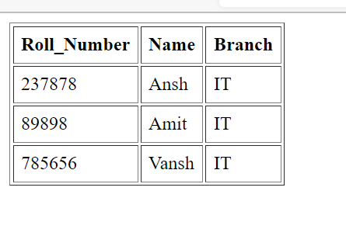
Cellspacing and cellpadding
<table border=1 cellpadding="6" cellspacing="2">

Slide 38
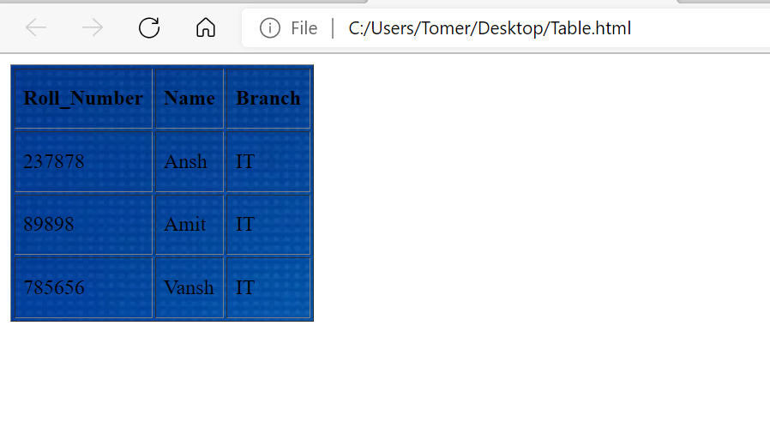
Background, width and height
<table background="C:\Users\Tomer\Desktop\img.jpg" border=1 cellpadding="6" cellspacing="2" width=200 height=200>

Slide 39
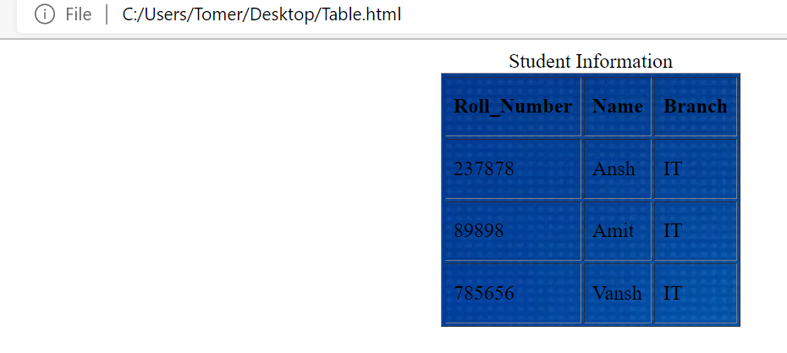
Align and caption
Align: Center left and right
Caption: heading for table
<table background="C:\Users\Tomer\Desktop\img.jpg" align=center border=1 cellpadding="6" cellspacing="2" width=200 height=200>
<caption>Student Information</caption>

Slide 40
TR
Attributes for the <tr> tag:
align - This establishes how the content of each row's cells are aligned. The options are left, right and center. The default is "center."
bgcolor - This is exactly as the "bgcolor" attribute for the <table> tag above except it only applies to the specific row this attribute is placed.
valign - This determines how the content of cells within this row are aligned vertically. The options are top, middle, bottom and baseline. The default is "middle." The option baseline lines up text within the row's cells.

Slide 41
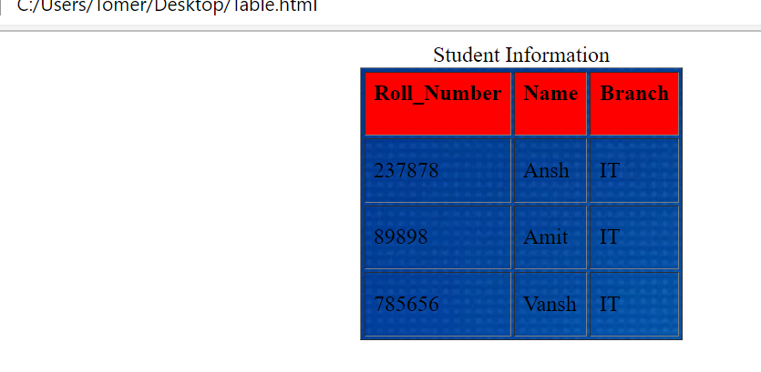

Example
<tr align=center bgcolor=red valign=top>
This will create a row within the table that will have all content aligned to the right. The row's cells will all have a background of red and the content will all appear at the top of the row's border.

Slide 42
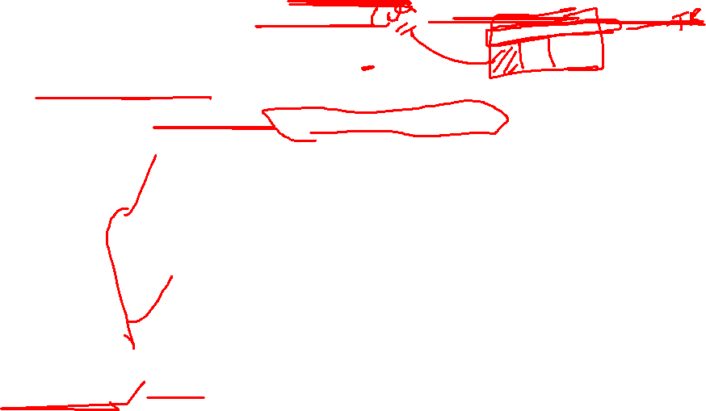
Attributes for the <td> tag:
align - This aligns the content of the <td> tag. The options are center, left, right and justify. The default is "left." Justify will make text so that it is aligned to both the right and left edges of the cell.
background - As with the background attribute for the <table> tag above except is only applies to the specific table cell.
bgcolor - As with the <table> and <tr> tags above except it only applies to the specific table cell.
height - This determines the height of the cell with either a specific number in pixels or by a percentage of the height of the table.

Slide 43
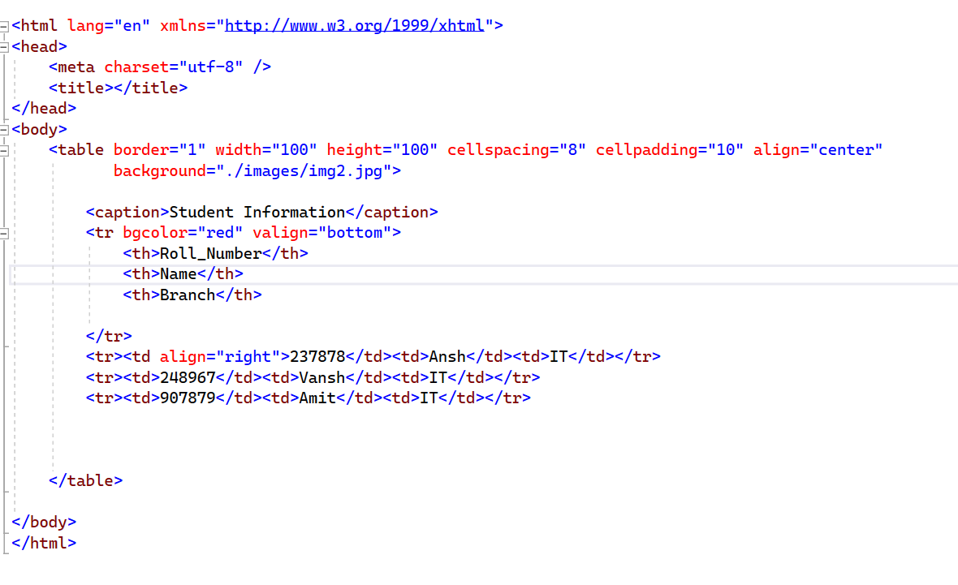
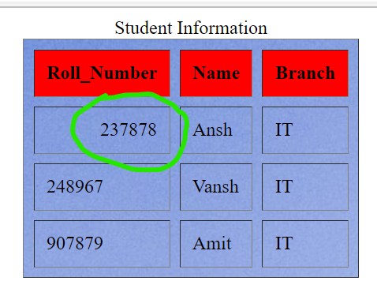
Example:

Slide 44
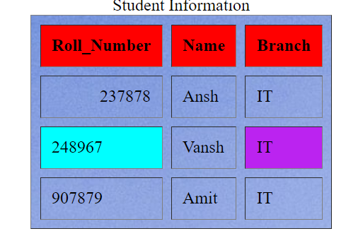
td bgcolor
<tr><td bgcolor="cyan">248967</td><td>Vansh</td><td bgcolor="#bbc23FF">IT</td></tr>

Slide 45
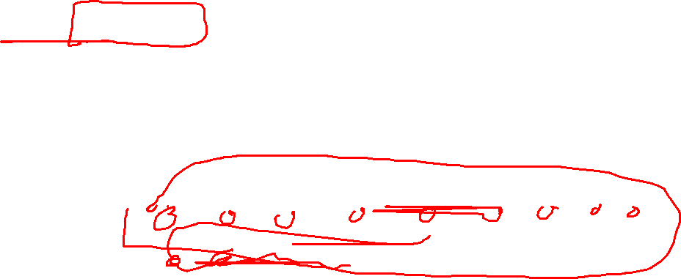
nowrap - This forces the table cell to be shown as wide as possible so as to display text on as few lines as possible. There are no perametors for nowrap.

Slide 46
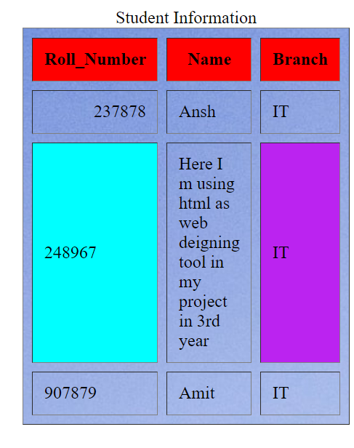
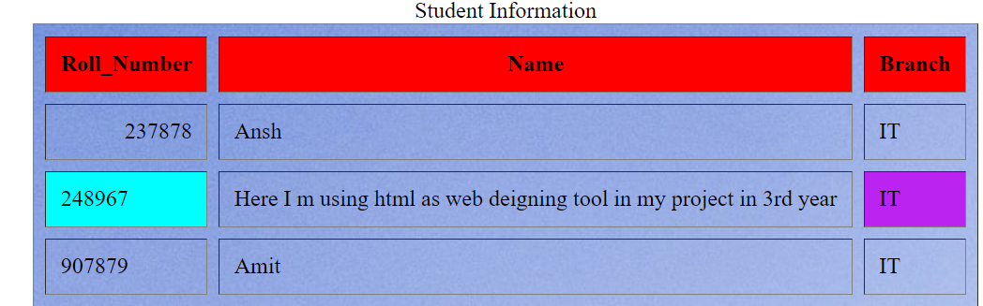
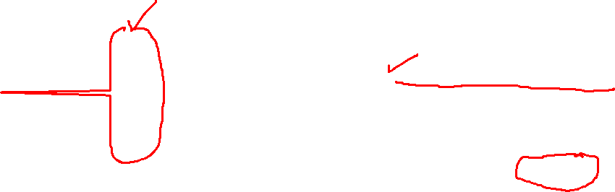
Nowrap attribute of <td>
With nowrap
Without nowrap

Slide 47
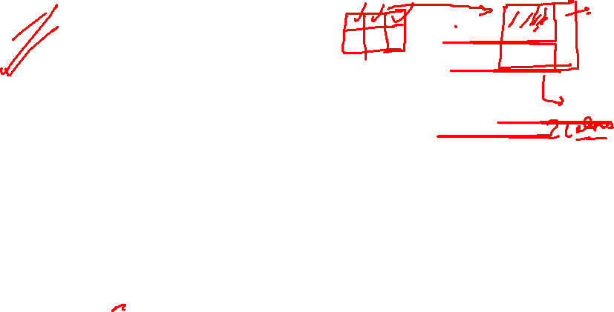
colspan - This is where it gets tricky. What this attribute tells the browser is to assume that this cell is spanning more than one cell location within the table. Or, in other words, colspan is used to create a multi-column cell. The default colspan is, obviously, 1. The tricky part is to make sure that the colspan numbers are identicall for each row of the table. If you have a four cells in one row of a table, then you can have two cells in another row as long as the colspan numbers for that row of cells equal four. Thus that row of cells could have one cell with a colspan of 3 and another with the default of 1. The first cell would cover the first three columns of the table and the last cell would match the last, or fourth column. See additional information below.

Slide 48
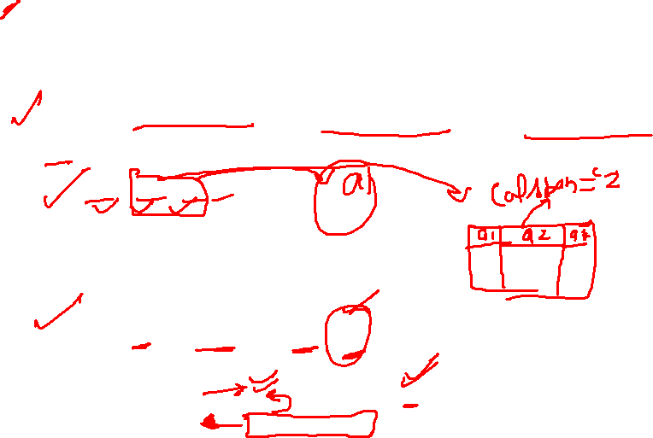
<th>: This is a table header cell tag. It is identical to the <td> tag in all respects except that any text placed within a <th> tag is automatically bolded and centered in most browsers.
<tr><td>a1</td><td>a2</td><td>a3</td><td>a4</td></tr>
<tr><td colspan="3">a1</td><td>a4</td></tr>
a1 | a2 | a3 | a4
b1 | b2 | b3 | B4
c1 | c2 | c3 | c4
a1 |  |  | a4
b1 | b2 | b3 | B4
c1 | c2 | c3 | c4

Slide 49
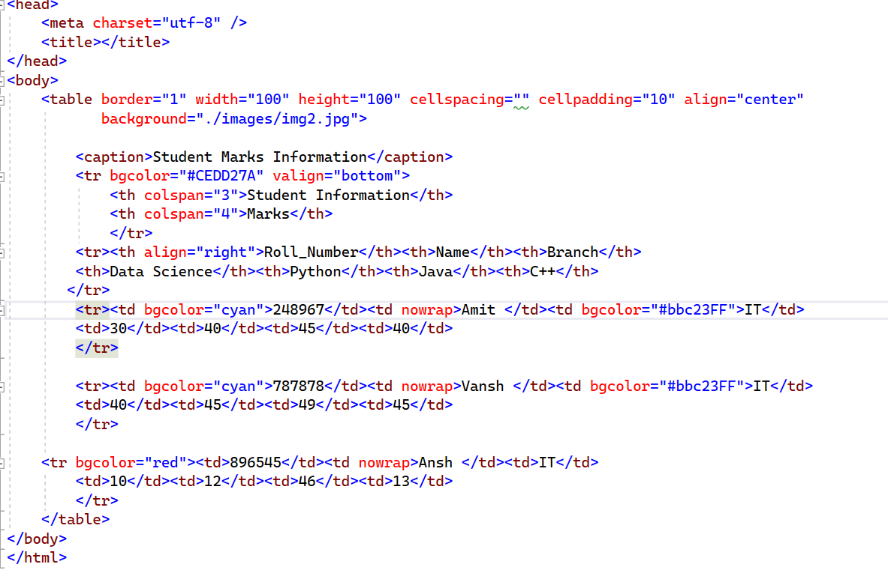
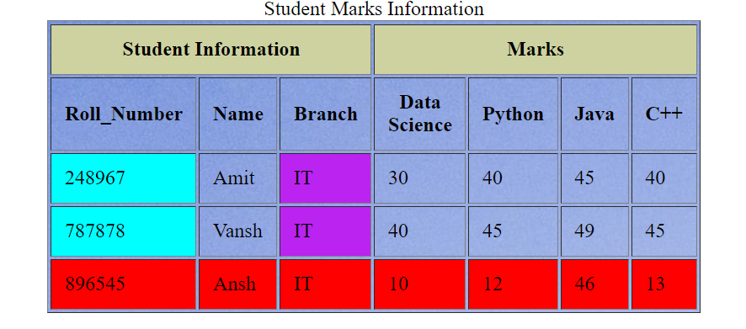
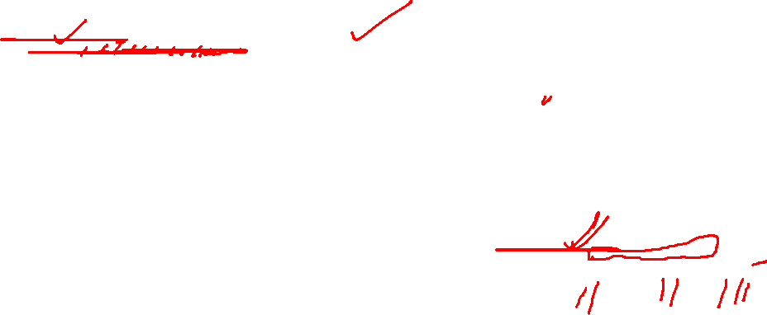

Slide 50
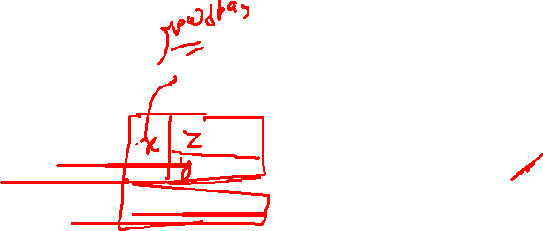
rowspan - This is exactly as "colspan" above, except it applies to a row of the table instead of the column. It is the number of rows through wich the current table cell extends downward through the table. This number should not be greater than the amount of remaining <tr> tags in the table. In other words, there should be "room" for the cell to extend downwards. Also, in all subsequent rows after a rowspan attribute has been used, you need one less <td> tag. See addintianal information below.
width - This determines the width of the specific table cell with either a number in pixels or a percentage of the width of the table.

Slide 51
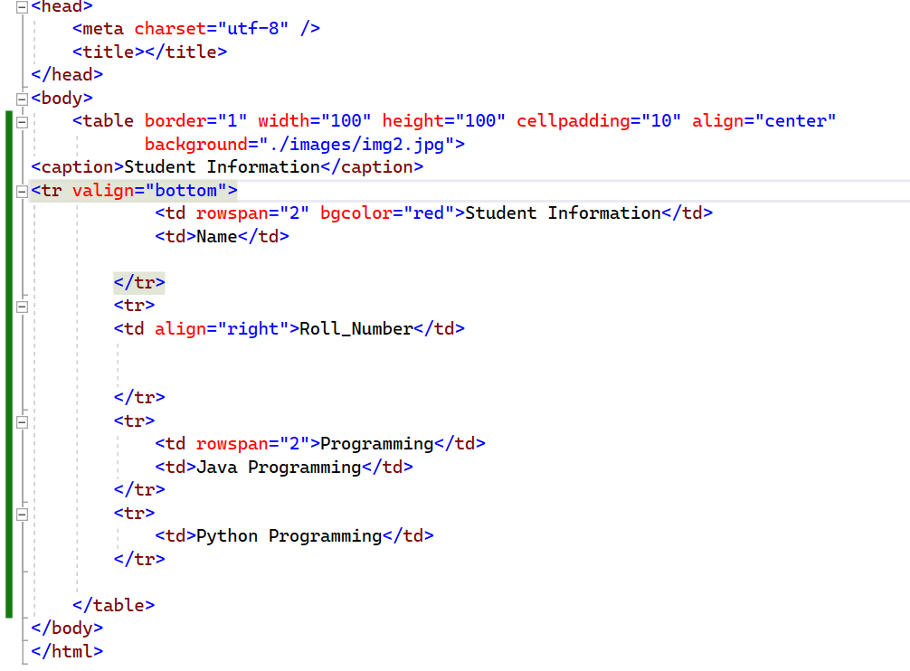
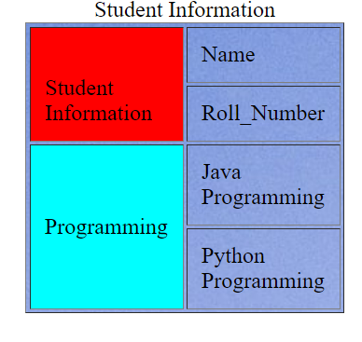


Slide 52
iFRAME
The <iframe> tag specifies an inline frame.
An inline frame is used to embed another document within the current HTML document.
Attribute:
Height: Specifies the height of an <iframe>. Default height is 150 pixels
Name: Specifies the name of an <iframe>
Src: Specifies the address of the document to embed in the <iframe>
Srcdoc: Specifies the HTML content of the page to show in the <iframe>

Slide 53
Width: Specifies the width of an <iframe>. Default width is 300 pixels
Example:
<iframe height=200 width=100 src=“htmlfile” name=“myframe”></iframe>
<a href=“Login.html" target=“myframe">Go to My Table</a>

Slide 54
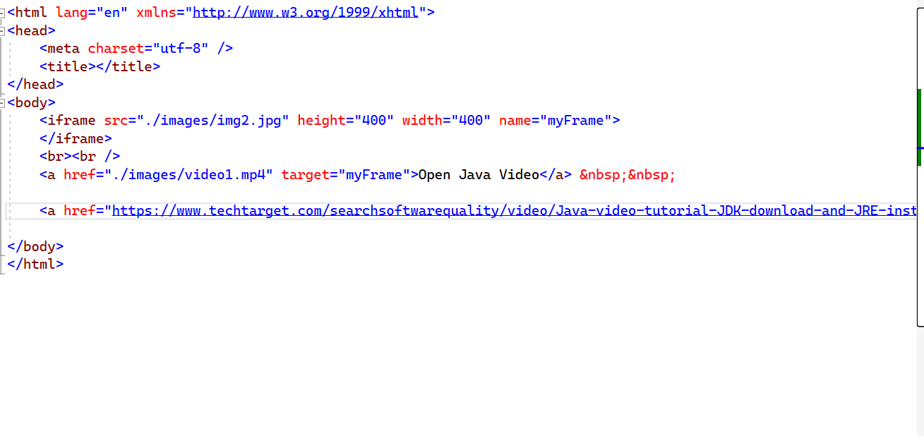
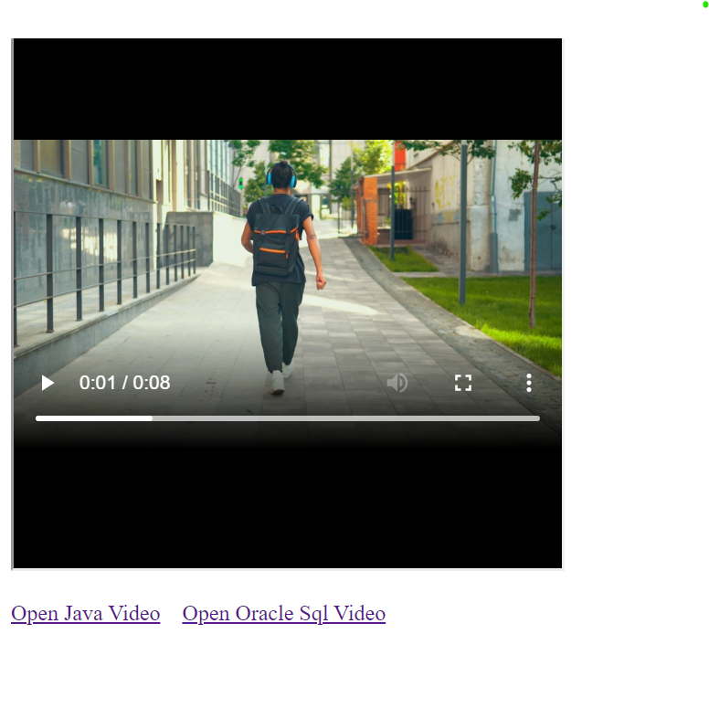

Slide 55
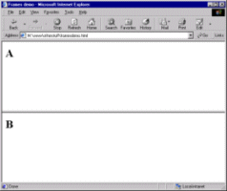
Frames in Html
Frames let you divide its main display window into independent window partitions or frames:
• Each simultaneously displaying a different document
• Something like a wall of monitors in a TV control room.

Slide 56
Frame Tags HTML uses three new tags to comprise the frame document:
frameset, frame, and noframes.
A is simply the collection of frames that make up the browser’s window.
Column (COLS) and row (ROWS attributes for the frameset tag let you define the number and initial sizes for the columns and rows of frames.
The <FRAMESET>tag replaces the <BODY> tag
<FRAMESET> AND <BODY> tags MUST NOT BE MIXED
The <FRAME> tag defines what document goes in the frames of the frameset

Slide 57
(Usually) HTML but could be otherwise.
You specify the (HTML) page to be loaded with the src attribute.
– You specify the link to be loaded with the name attribute.
– Other attributes may be set, E.g. scrolling of individual frames.
• The <NOFRAMES> tag allows for browsers that can’t process frames

Slide 58
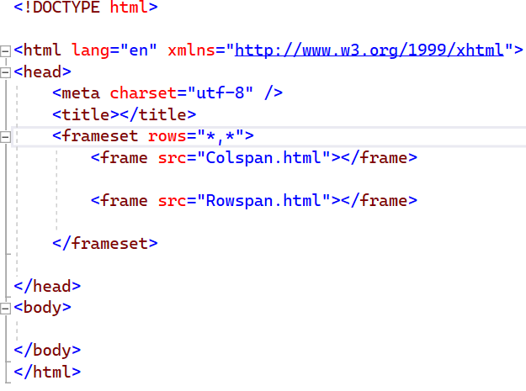


Slide 59



Slide 60


<FRAMESET COLS="15%, *"> <FRAME SRC="a.html"> <FRAME SRC="b.html"> </FRAMESET>
<FRAMESET ROWS="15%, 60%, 25%"> <FRAME SRC="a.html"> <FRAME SRC="b.html"> <FRAME SRC="c.html"> </FRAMESET>

Slide 61
FRAMEBORDER
BORDER=n
where n is the thickness of the border, in pixels, between all frames in the frameset. (If you've turned borders off via FRAMEBORDER, this attribute is of course irrelevant.)
FRAMESPACING=n where n is a number of pixels of additional space between frames. Only works in IE.
BORDERCOLOR=rgb code or colour name

Slide 62



Slide 63
Html Forms
The <Form> Tag
You place a form anywhere inside the body of an HTML document with its elements enclosed by the <form> tag and its respective end tag </form>
Any tag which is allowed inside of the <BODY> container is allowed inside a form.
Headings, paragraphs, lists, tables, images, links -- anything and everything goes.
In addition, there are certain tags which are allowed to exist inside a form, and nowhere else.

Slide 64
This tag has two attributes which must be used if the form is to work correctly.
METHOD has two possible values:
POST Contacts the server (CGI program) and once connection established sends data
GET Contacts the server (CGI program) and sends data in a single transaction. (More on this later).
ACTION attribute contains the URL of the CGI program which processes the data sent by the browser. The value of ACTION can be either a relative or a full URL. The action attribute can also be a URL to an email address or such thing.
<FORM method="post" action=“Home.jsp"> </FORM>

Slide 65
Entering Data
There are several ways for the user to enter data in a form. They basically involve either typing text or selecting a button, list or menu item with a mouse.
Input items include:
Text Box
Text Area
Radio Button
Check box
Pop-up Box
Image Buttons or Image Maps

Slide 66
Text Input
A text input is simply a box in which anything can be typed -- letters, numbers, or anything else -- via the keyboard. In most browsers, the box is twenty characters wide, but this can vary.
Simply set the type attribute of the input tag to get a text input box:
<label></label><input type="text">
which would result result in:

Slide 67




Type | Description | Example
button | A push button with no default behavior displaying the value of the value attribute, empty by default. | <input type="button" value="Login" />
checkbox | A check box allowing single values to be selected/deselected. | <input type="button" value="Login" />
color | A control for specifying a color; opening a color picker when active in supporting browsers. | ><input type="color" />
date | A control for entering a date (year, month, and day, with no time). Opens a date picker or numeric wheels for year, month, day when active in supporting browsers. | <input type="button" value="Login" />

Slide 68

Type | Description | Example
datetime-local | A control for entering a date and time, with no time zone. Opens a date picker or numeric wheels for date- and time-components when active in supporting browsers. | <input type="datetime-local" />
email | A field for editing an email address. Looks like a text input, but has validation parameters and relevant keyboard in supporting browsers and devices with dynamic keyboards. | <input type=“email" />
file | A control that lets the user select a file. Use the accept attribute to define the types of files that the control can select. | <tr><td>Upload Photo</td><td><input type="file" /></td></tr>
password | A single-line text field whose value is obscured. Will alert user if site is not secure. | <input type=“password"/>

Slide 69
Type | Description | Example
radio | A radio button, allowing a single value to be selected out of multiple choices with the same name value. | <input type=“radio" />
range | A control for entering a number whose exact value is not important. Displays as a range widget defaulting to the middle value. Used in conjunction min and max to define the range of acceptable values. | <input type=“range“ min=“10” max=“100” />
reset | A button that resets the contents of the form to default values. Not recommended. | <input type=“reset”>
text | The default value. A single-line text field. Line-breaks are automatically removed from the input value. | <input type=“text"/>

Slide 70
More Attributes of INPUT tag:
Name, size, style, maxlength, submit,password, radiobutton, checkbox etc
Example:
Submit:
<form> <input type="submit" name = "left" value = "left">
<input type="submit" name = "right" value = "right">
<input type="submit" name = "up" value = "up">
<input type="submit" name = "down" value = "down"> </form>
left
right
up
down

Slide 71
password input:
Password inputs are similar to text inputs -- accept any input from the keyboard, they can have SIZE and MAXLENGTH attributes etc. For example:
<INPUT type="password" name="pwd" size=15 maxlength=15>

Slide 72
Select
Let's say you want to have your readers indicate which country they live in.
You could create a radio-button input listing all two-hundred-plus countries in the world,
but that would obviously take up a lot of space on the screen.
How can you avoid this unsightly mess?
The <SELECT> tag is used to create the environment and each choice in the select list is defined using the <OPTION> tag

Slide 73
<P> What Continent are you from?
<SELECT name="access">
<OPTION> Europe
<OPTION> America
<OPTION> Australasia
<OPTION> Asia
<OPTION> Oops, Wrong planet!!
<optgroup label="Cyber City">
<option>Bengluru</option>
<option>Hyderabad</option>
</optgroup>
</SELECT> </P>

Slide 74
Textarea
The TEXTAREA tag is used to create a box where the user may type large amounts of text at will. A typical use for TEXTAREA is to ask users to input general comments they may have about a Web site. In addition to having some special attributes, TEXTAREA is a container, so the close-tag is required.
For example:
<TEXTAREA name="comments" rows=5 cols=65> </TEXTAREA>
rows and cols give the dimension of the textarea in characters.

